Slide 1
Azure Storage Services
Walkthrough of Azure Blob Storage and Azure Queue
Joseph Guadagno
http://www.josephguadagno.net
@jguadagno

Slide 2
Who Am I?
Microsoft .NET MVP
Since 2009
ASP.NET Insider
Since Jan 2015
Software Architect – Quicken Loans
Since 2013
Vice President – INETA North America
Since 2008
Father of two
Husband of One
Social Media Addict
@jguadagno

Slide 3
Microsoft Azure Offerings

Slide 4
What does Microsoft Azure offer?
Compute
Virtual Machines, Cloud Services, Websites, Mobile Services
Data Services
Storage, SQL Database, HDInsight, Cache, Backup, and more
App Services
Media Services, Service Bus, Push Notifications, Active Directory, and more
Network Services
Express Route, Virtual Network, Traffic Manager

Slide 5
What is Microsoft Azure Cloud Services?
When you create an application and run it in Azure, the code and configuration together are called an Azure cloud service (known as a hosted service in earlier Azure releases).
By creating a cloud service, you can deploy a multi-tier web application in Azure, defining multiple roles to distribute processing and allow flexible scaling of your application. A cloud service consists of one or more web roles and/or worker roles, each with its own application files and configuration. Azure Websites and Virtual Machines also enable web applications on Azure. The main advantage of cloud services is the ability to support more complex multi-tier architectures.

Slide 6
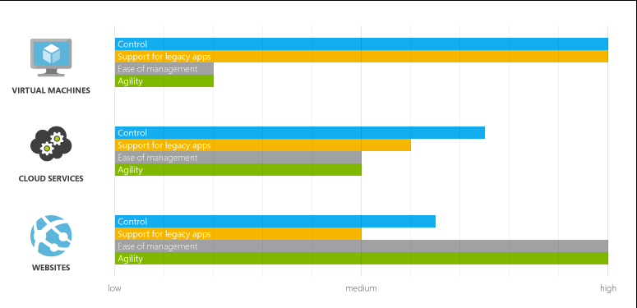
Comparing Azure Websites, Cloud Services, and Virtual Machines

Slide 7
Azure Cloud Services

Slide 8
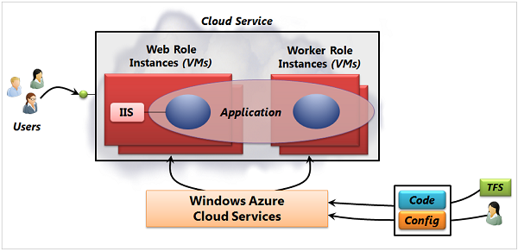
Microsoft Azure Cloud Services

Slide 9
Key Terms In Microsoft Azure Cloud Services
Cloud Service Role
Web Role
Worker Role
Role Instance
Guest Operating System
Cloud Service Components
Service definition file
Service configuration file
Service package

Slide 10
Azure Storage Services
A standard storage account gives you access to Blob storage, Table storage, Queue storage, and File storage:
Blob storage stores file data. A blob can be any type of text or binary data, such as a document, media file, or application installer.
Table storage stores structured datasets. Table storage is a NoSQL key-attribute data store, which allows for rapid development and fast access to large quantities of data.
Queue storage provides reliable messaging for workflow processing and for communication between components of cloud services.
File storage (Preview) offers shared storage for legacy applications using the standard SMB 2.1 protocol. Azure virtual machines and cloud services can share file data across application components via mounted shares, and on-premise applications can access file data in a share via the File service REST API. File storage is available by request via the Azure Preview page.
Each standard storage account can contain up to 500 TB of combined blob, queue, table, and file data. See the Azure Storage Scalability and Performance Targets for details about standard storage account capacity.

Slide 11
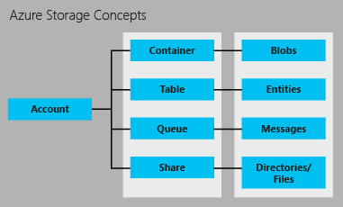
Azure Storage Concepts

Slide 12
Blob Storage
For users with large amounts of unstructured data to store in the cloud, Blob storage offers a cost-effective and scalable solution. You can use Blob storage to store content such as:
Documents
Social data such as photos, videos, music, and blogs
Backups of files, computers, databases, and devices
Images and text for web applications
Configuration data for cloud applications
Big data, such as logs and other large datasets

Slide 13
Table Storage
Modern applications often demand data stores with greater scalability and flexibility than previous generations of software required. Table storage offers highly available, massively scalable storage, so that your application can automatically scale to meet user demand. Table storage is Microsoft’s NoSQL key/attribute store – it has a schemaless design, making it different from traditional relational databases. With a schemaless data store, it's easy to adapt your data as the needs of your application evolve. Table storage is easy to use, so developers can create applications quickly. Access to data is fast and cost-effective for all kinds of applications. Table storage is typically significantly lower in cost than traditional SQL for similar volumes of data.
Table storage is a key-attribute store, meaning that every value in a table is stored with a typed property name. The property name can be used for filtering and specifying selection criteria. A collection of properties and their values comprise an entity. Since Table storage is schemaless, two entities in the same table can contain different collections of properties, and those properties can be of different types.

Slide 14
Queue Storage
In designing applications for scale, application components are often decoupled, so that they can scale independently. Queue storage provides a reliable messaging solution for asynchronous communication between application components, whether they are running in the cloud, on the desktop, on an on-premises server, or on a mobile device. Queue storage also supports managing asynchronous tasks and building process workflows.
A storage account can contain any number of queues. A queue can contain any number of messages, up to the capacity limit of the storage account. Individual messages may be up to 64 KB in size.

Slide 15
File Storage
Many legacy applications rely on file shares, a dependency that has complicated moving these applications to the cloud. File storage offers cloud-based file shares, so that you can migrate legacy applications to Azure quickly and without costly rewrites.
Applications running in Azure virtual machines or cloud services can mount a File storage share to access file data, just as a desktop application would mount a typical SMB share. Any number of application components can mount and access the File storage share simultaneously.
Since a File storage share is a standard SMB 2.1 file share, applications running in Azure can access data in the share via file sytem I/O APIs. Developers can therefore leverage their existing code and skills to migrate existing applications. IT Pros can use PowerShell cmdlets to create, mount, and manage File storage shares as part of the administration of Azure applications.

Slide 16
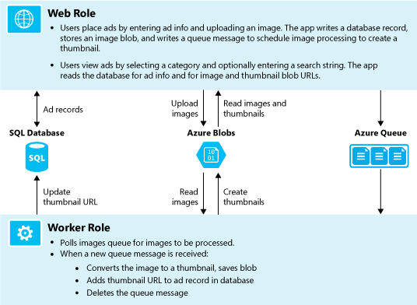
The Demo

Slide 17
Demo
Azure Photos

Slide 18
Blob Storage

Slide 19
Working with Blob Storage
Create the account
Setup the storage connection string
Create the container
Upload a blob to a container
Download blob
Delete blobs
http://azure.microsoft.com/en-us/documentation/articles/storage-dotnet-how-to-use-blobs/

Slide 20
Blob Storage Concepts
Joe
photos
Photo1.jpeg
Photo2.jpeg
thumbnails
Photo1.jpeg
Account
Container
Blob

Slide 21
Demo
Blob Storage

Slide 22
Queue Storage

Slide 23
Queue Storage
Setup an Azure Storage connection string
Create the Queue
Insert a message into the queue
Peek at the next message in the queue
Dequeue (delete) the message
http://azure.microsoft.com/en-us/documentation/articles/storage-dotnet-how-to-use-queues/

Slide 24
Queue Concepts
Account
Thumbnail creation
image.1
image.2
SaveImageToCdn
Image.1
Storage Account
Queue
Message

Slide 25
Demo
Queue Storage

Slide 26
References
What is a Cloud Service?
http://azure.microsoft.com/en-us/documentation/articles/cloud-services-what-is/
Azure Storage Explorer
http://azurestorageexplorer.codeplex.com/
Configuration Settings for Storage Accounts:
http://www.windowsazure.com/en-us/documentation/articles/storage-dotnet-how-to-use-blobs-20/#setup-connection-string
Access Blog:
http://www.windowsazure.com/en-us/documentation/articles/storage-dotnet-how-to-use-blobs-20/#configure-access
Website Diagnostics:
http://www.windowsazure.com/en-us/documentation/articles/web-sites-enable-diagnostic-log/
http://www.windowsazure.com/en-us/documentation/articles/web-sites-dotnet-troubleshoot-visual-studio
http://azure.microsoft.com/en-us/documentation/articles/cloud-services-dotnet-get-started/

Slide 27
Contact Information
Email
jguadagno@hotmail.com
Website
http://www.josephguadagno.net
Twitter
@jguadagno
Code Samples
http://jjg.me/AzurePhotos

